Slide 1

Secure File Upload System Overview
Project built with Python Django featuring login/signup, email approvals, AES-256 encryption, and AWS S3 secure storage.

Slide 2

Problem Statement
Data Security Needs
Access Control
Protect sensitive file uploads in web apps
Restrict upload permissions to authorized users only
User Authorization
Real-time email approval for critical actions

Slide 3





Project Objectives
Secure Authentication
Email Approval
Encrypted Uploads
Verification before sensitive actions
Protect files using AES-256 encryption
Robust login and signup mechanisms
Safe Storage
Upload encrypted files to AWS S3

Slide 4
System Flowchart
User opens the app
Signup or login
Email approval for login
Access upload page
Select file to upload
Email approval for file upload
Encrypt file using AES-256
Upload encrypted file to AWS S3

Slide 5

Key Modules Used
Django Framework
SMTP & Email Backend
Backend web framework
Send real-time approval emails
PyCryptodome
boto3
AES-256 encryption library
AWS S3 storage integration

Slide 6
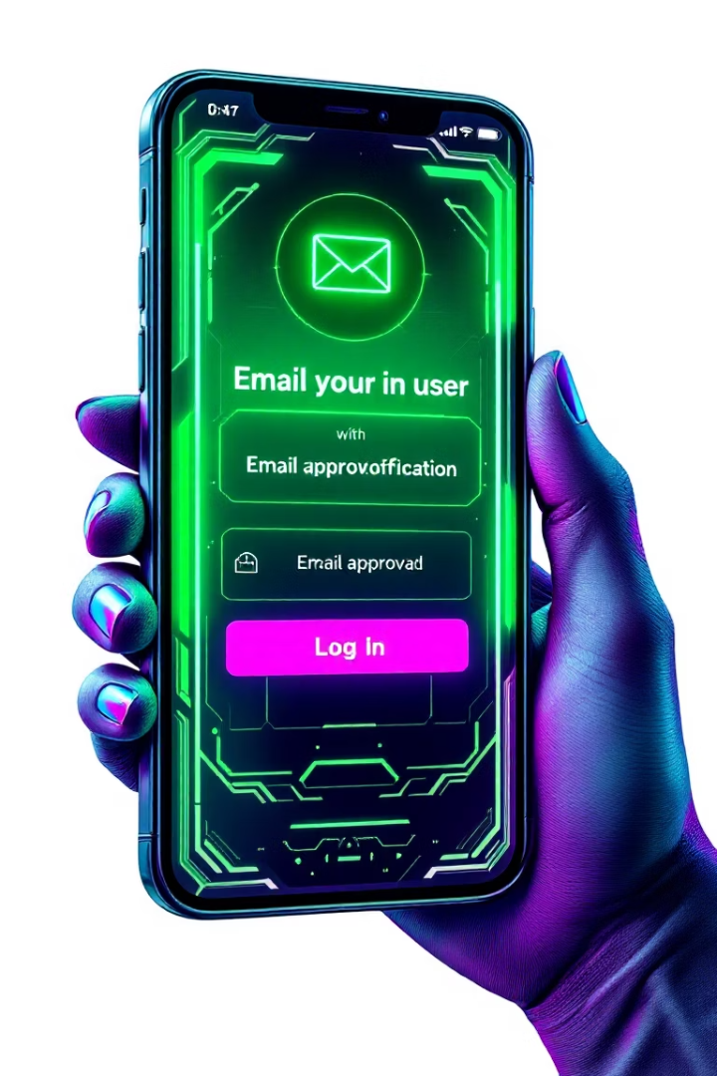
Login and Signup Workflow
User Signup/Login
Initial account creation and access
Email Approval
Approve or deny login via email link
Grant Access
Create session and show upload page

Slide 7





File Upload Process
Select File
User chooses file on upload page
Send Approval Email
Email includes file information for approval
Encrypt File
Using AES-256 in CFB mode
Upload to AWS S3
Store encrypted file securely in cloud

Slide 8
AES-256 Encryption Details
Key Features
Security Measures
256-bit encryption key
Key stored securely or derived via passphrase
CFB mode with Initialization Vector (IV)
Strong cryptographic standards
Block-by-block file processing

Slide 9
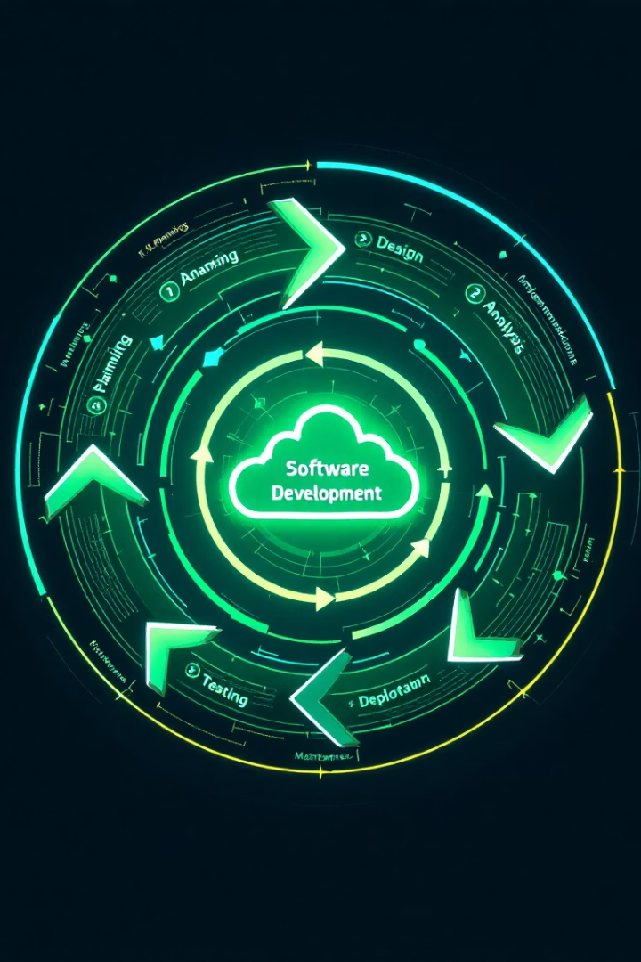
Project Lifecycle & Use Cases
1
Phases
Requirement to Deployment in 6 steps
2
Use Cases
Corporate document submission, cloud security

Slide 10

Conclusion and Future Scope
Achievements
End-to-end secure upload
Two-step email approval
AES-256 encryption integration
Future Enhancements
OTP email validation
Time-limited approval links
Dashboard for history & management

